Slide 1
Capacity for Position
Pierce Nichols
Teardown 2025

Slide 2
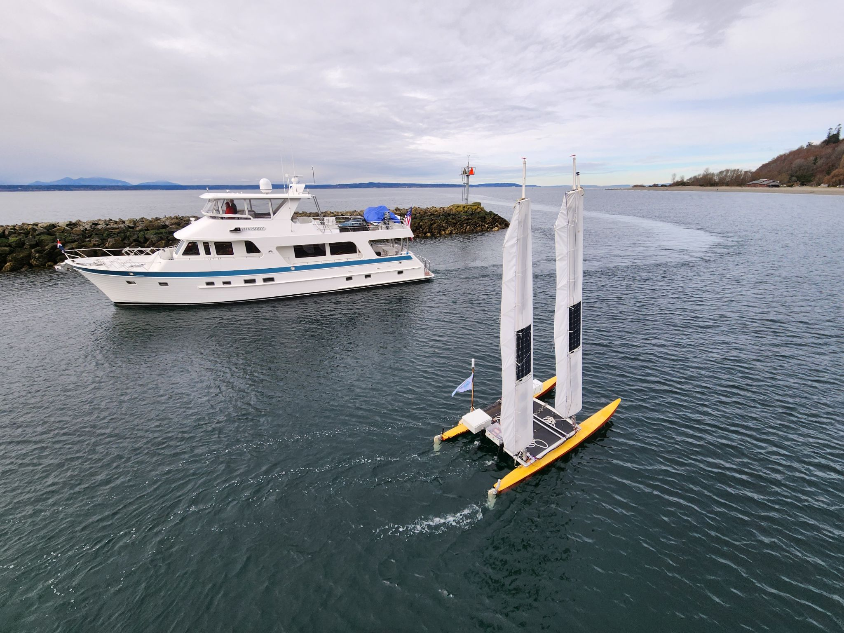
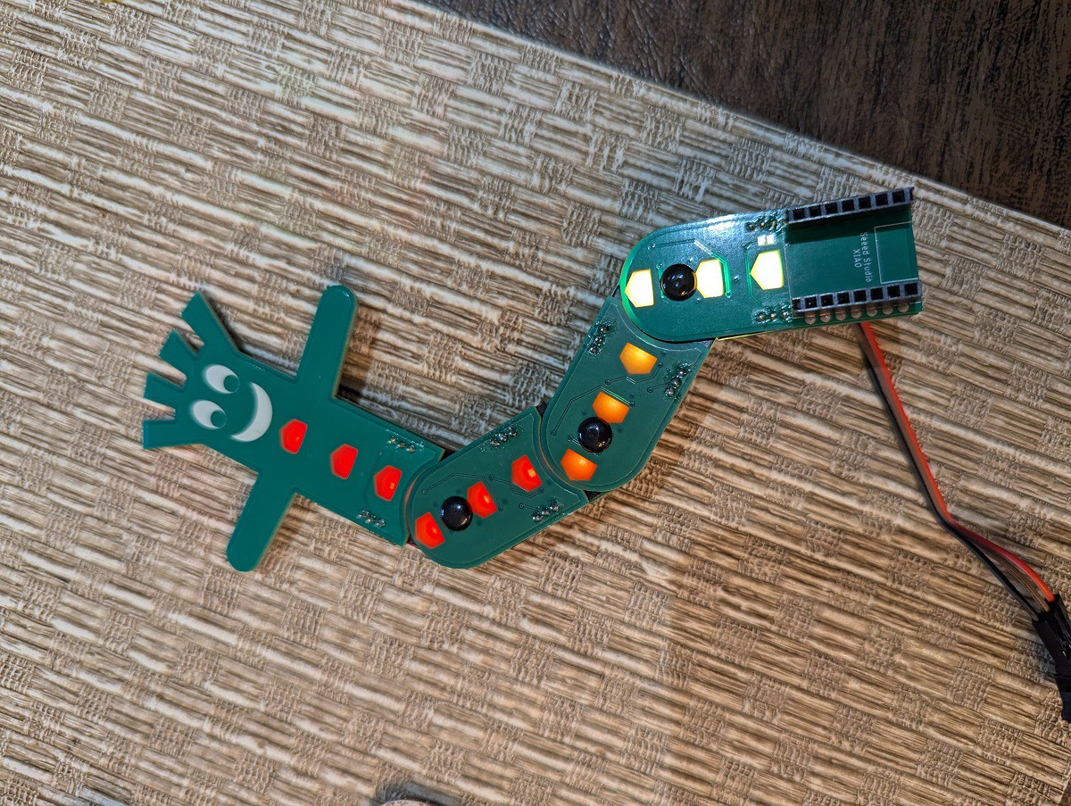
Motivation
Robot Sailboat
Bendy SAO

Slide 3
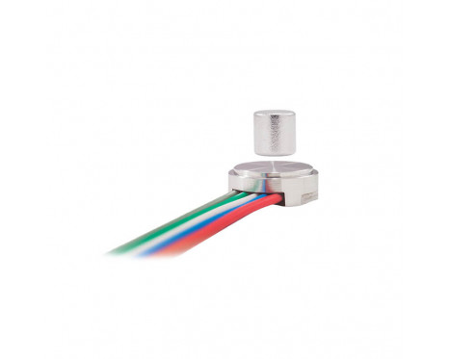
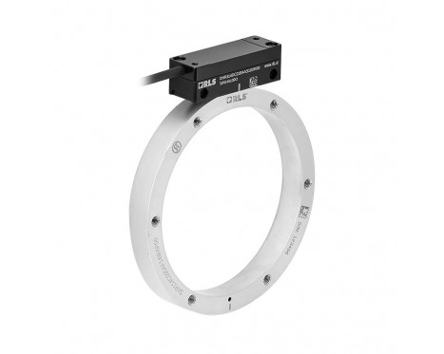
What can we buy?
Environmentally Sealed Rotary Position Sensors are Expensive
~$100/sensor for on-axis
  Rotational axis is prime real estate
~$1000/sensor for off-axis
All non-starters for things like Bendy SAO

Slide 4
What About Capacitance?
Capacitive touch hardware built into most microcontrollers
Sensors are just PCBs, so we can do whatever we want
It should work for linear position as well

Slide 5
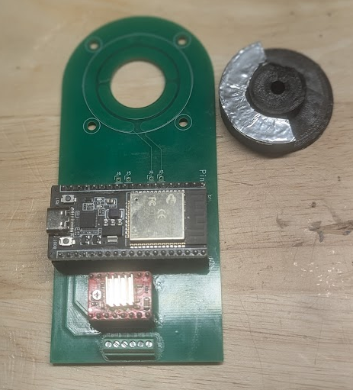
First Try
ESP32 dev board
Adafruit touch library
Four pads in pairs set at 90 degrees (sin and cos)
Stepper mounted for test/evaluation
Doesn’t really work…

Slide 6
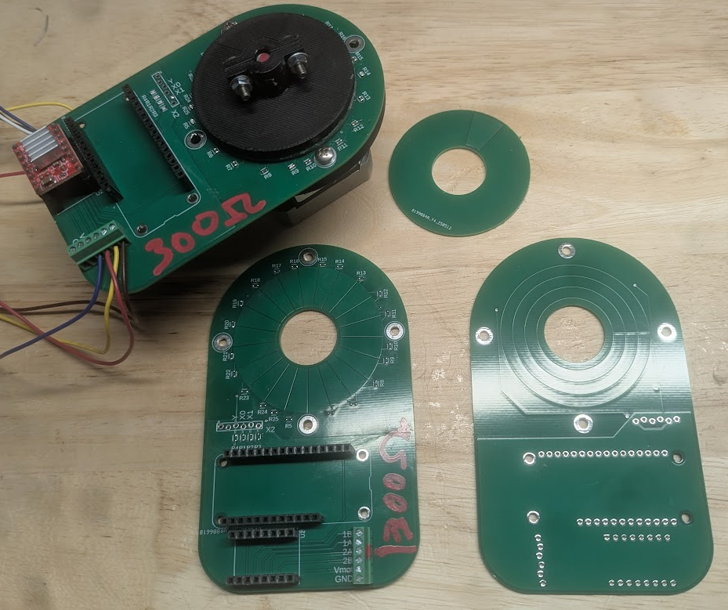
Microchip QTouch
Adafruit Feather M0 board
QTouch library
Two-layer mutual inductance rotor
Stepper mounted for test/evaluation
Defeated by auto-calibration

Slide 7
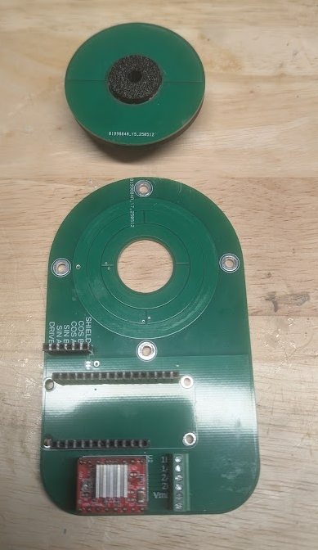
Something a little different
Rotor (half copper)
Adafruit Feather M0 board
Outer drive ring
Two split inner sense rings, rotated 90 degrees
Drive
Sine A
Sine B
Cosine A
Cosine B

Slide 8
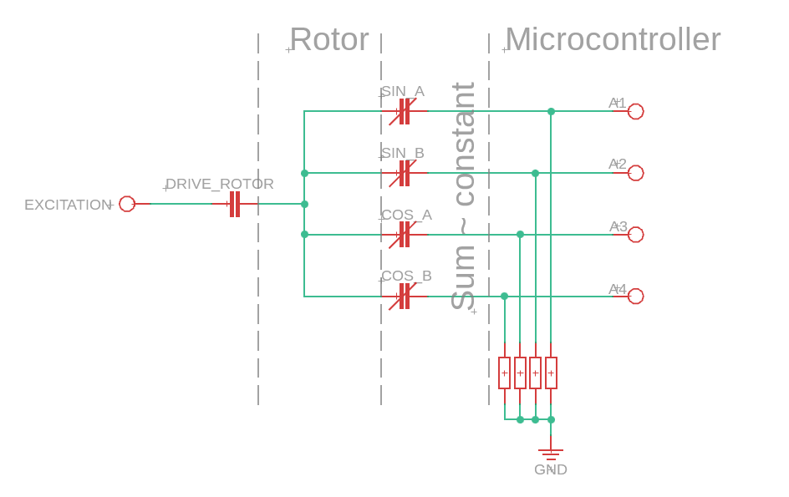
Equivalent Circuit
Internal impedance too low, uncertain

Slide 9
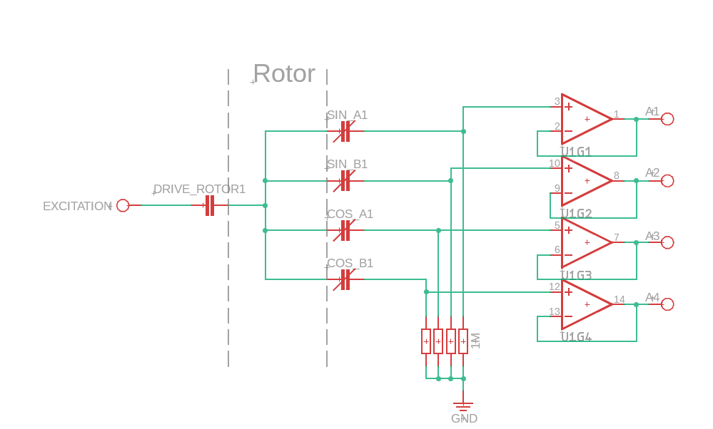
A better circuit
Near infinite input impedance
Accurate drain resistance

Slide 10
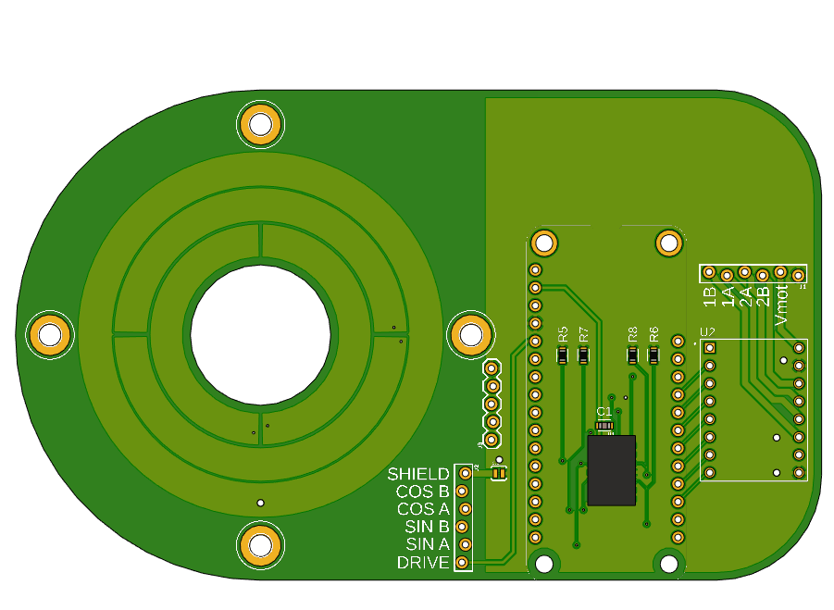
Revised board
Adafruit Feather M0
A4988 stepper driver
Shielding ground plane on the back

Slide 11
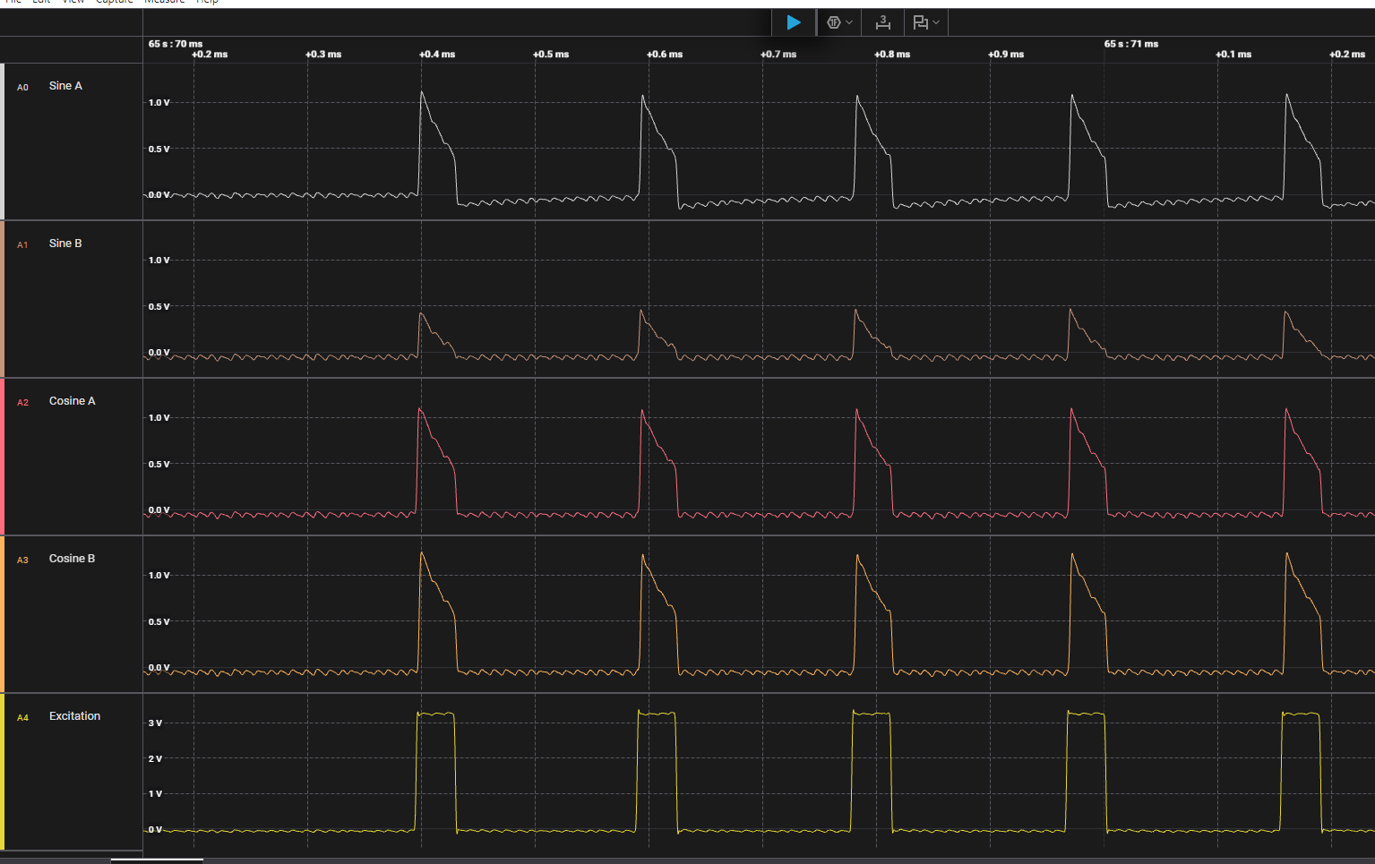
Sensing procedure
Put a square pulse on the drive ring
Wait for a set period
Measure the voltage on the sense pin
Repeat once for each sense pin

Slide 12
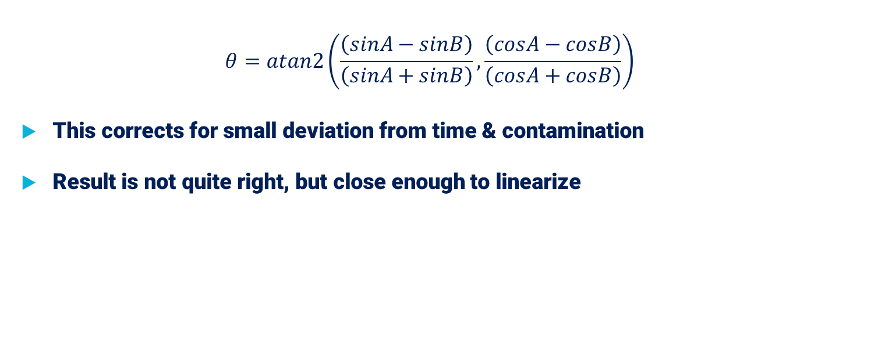
Calculate the angle
$$θ=atan2\left(\frac{\left(sinA−sinB\right)}{\left(sinA+sinB\right)},\frac{\left(cosA−cosB\right)}{\left(cosA+cosB\right)}\right)$$
This corrects for small deviation from time & contamination
Result is not quite right, but close enough to linearize

Slide 13
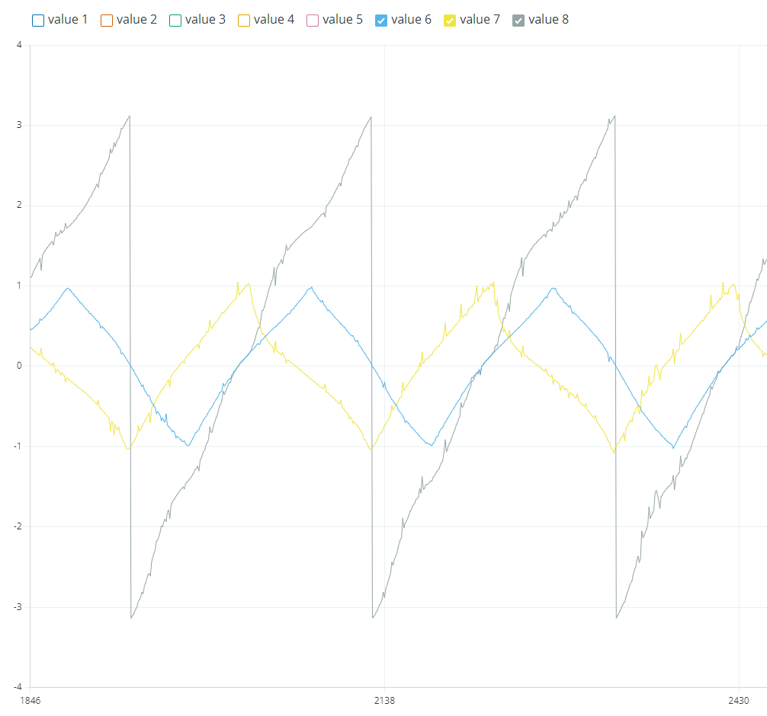
Results
“Sine” and “Cosine” are triangle waves (sort of)
Raw accuracy is ±10 degrees
With filtering & linearization, can get ±3 degrees
Good enough for Bendy SAO, not for sailing robot

Slide 14
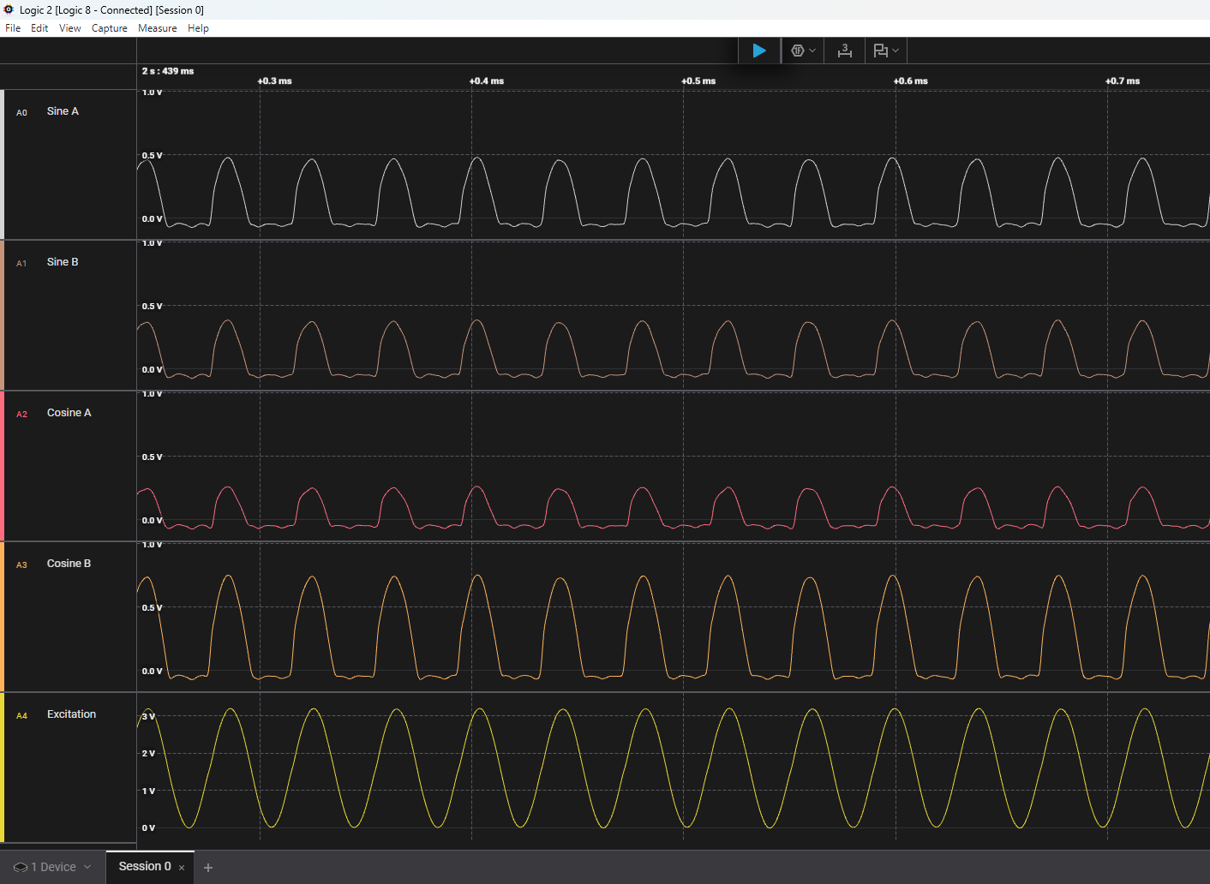
A different approach
Sinusoidal excitation
Each leg of the circuit functions as a variable high-pass filter.
We can use a lock-in amplifier to filter most of the noise.

Slide 15
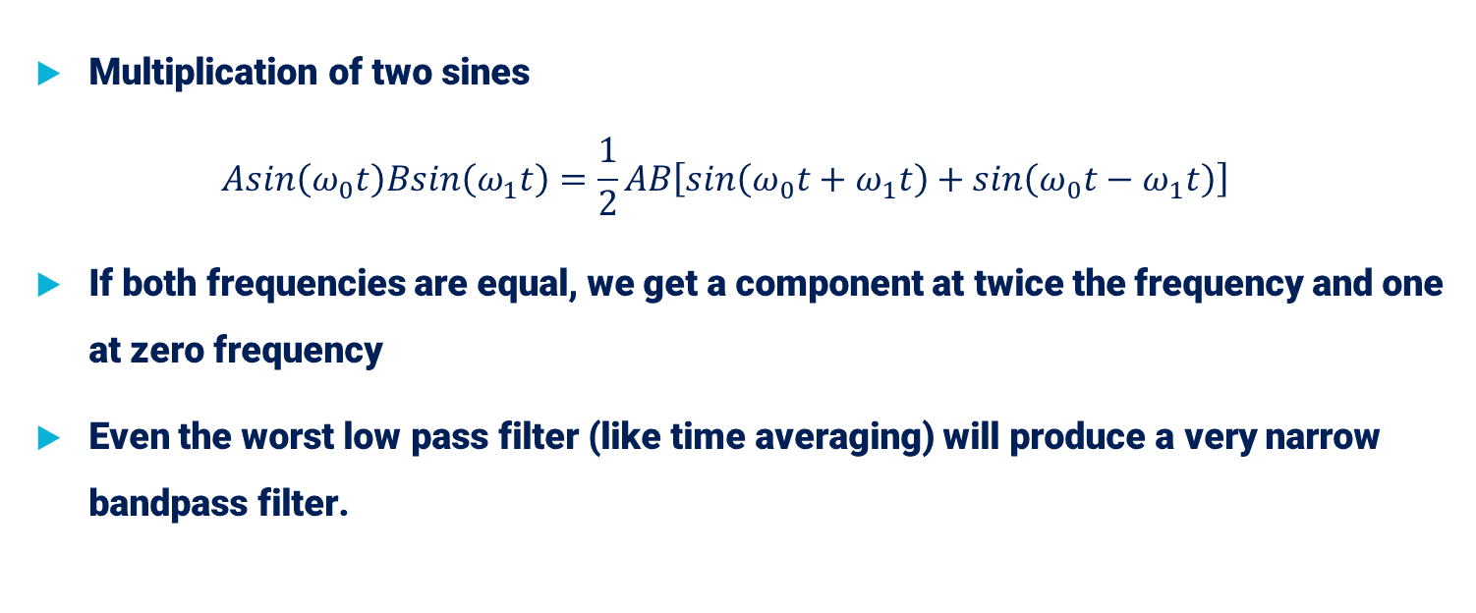
Review of Lock-in Amplifier
Multiplication of two sines
$Asin\left(ω_{0}t\right)Bsin\left(ω_{1}t\right)=\frac{1}{2}AB\left[sin\left(ω_{0}t+ω_{1}t\right)+sin\left(ω_{0}t−ω_{1}t\right)\right]$
If both frequencies are equal, we get a component at twice the frequency and one at zero frequency
Even the worst low pass filter (like time averaging) will produce a very narrow bandpass filter.

Slide 16
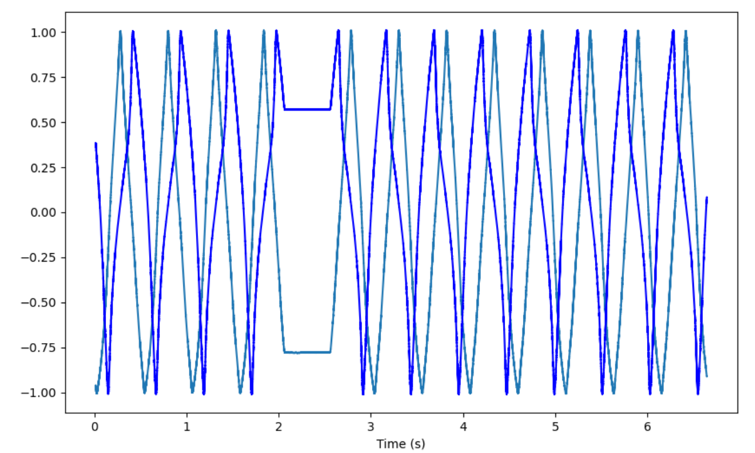
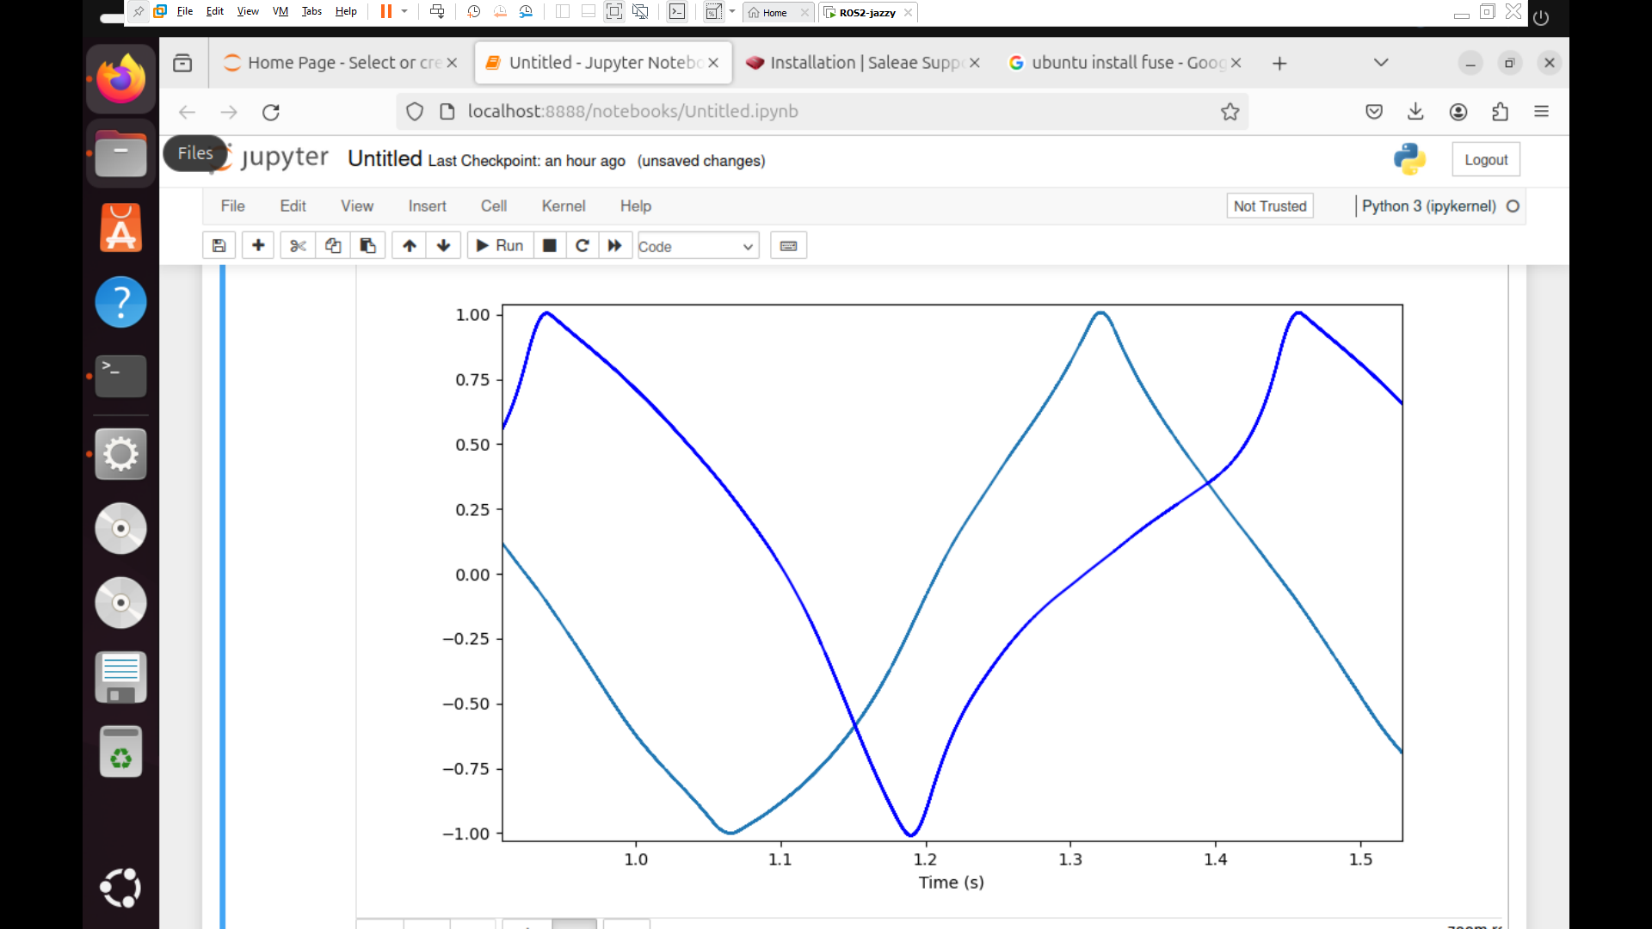
Quick Check with Saleae & Jupyter

Slide 17
Sources of Non-Linearity
Capacitive coupling to nearby metal
  Probably not – experiments with adding & subtracting parts didn’t change behavior
The four legs of the circuit influence each other
  Confirmed by disconnecting legs

Slide 18

Conclusion
Robot Sailboat
Bendy SAO

Slide 19
Future Work
Experiment with different size rotors
Experiment with different rotor arrangements
Write a library for sinusoidal excitation
Figure out how to deal with calibration for QTouch

Slide 20
References & Resources
QTouch App Note https://www.mouser.com/pdfDocs/QTouch_QTAN0079.pdf
QTouch Layout Guide https://www.microchip.com/content/dam/mchp/documents/OTH/ApplicationNotes/ApplicationNotes/Atmel-42094-QTouch-Schematic-and-Layout-Checklist_ApplicationNote_AT02259.pdf
Capacitor Impedance Calculator https://www.allaboutcircuits.com/tools/capacitor-impedance-calculator/
Capacitance Calculator https://www.omnicalculator.com/physics/capacitance
Modifying Arduino IDE Serial Plotter https://github.com/arduino/arduino-ide/issues/803#issuecomment-1338149431
Basic Capacitive Position Library https://github.com/logos-electromechanical/CapPosnBasic
Hackaday IO page https://hackaday.io/project/203347-capacity-for-position

Slide 21
QUESTIONS?
piercenichols@gmail.com
Mastodon: @nocleverhandle@social.seattle.wa.us
BlueSky: @nocleverhandle.bsky.social
And I am currently looking for work

